Slide 1
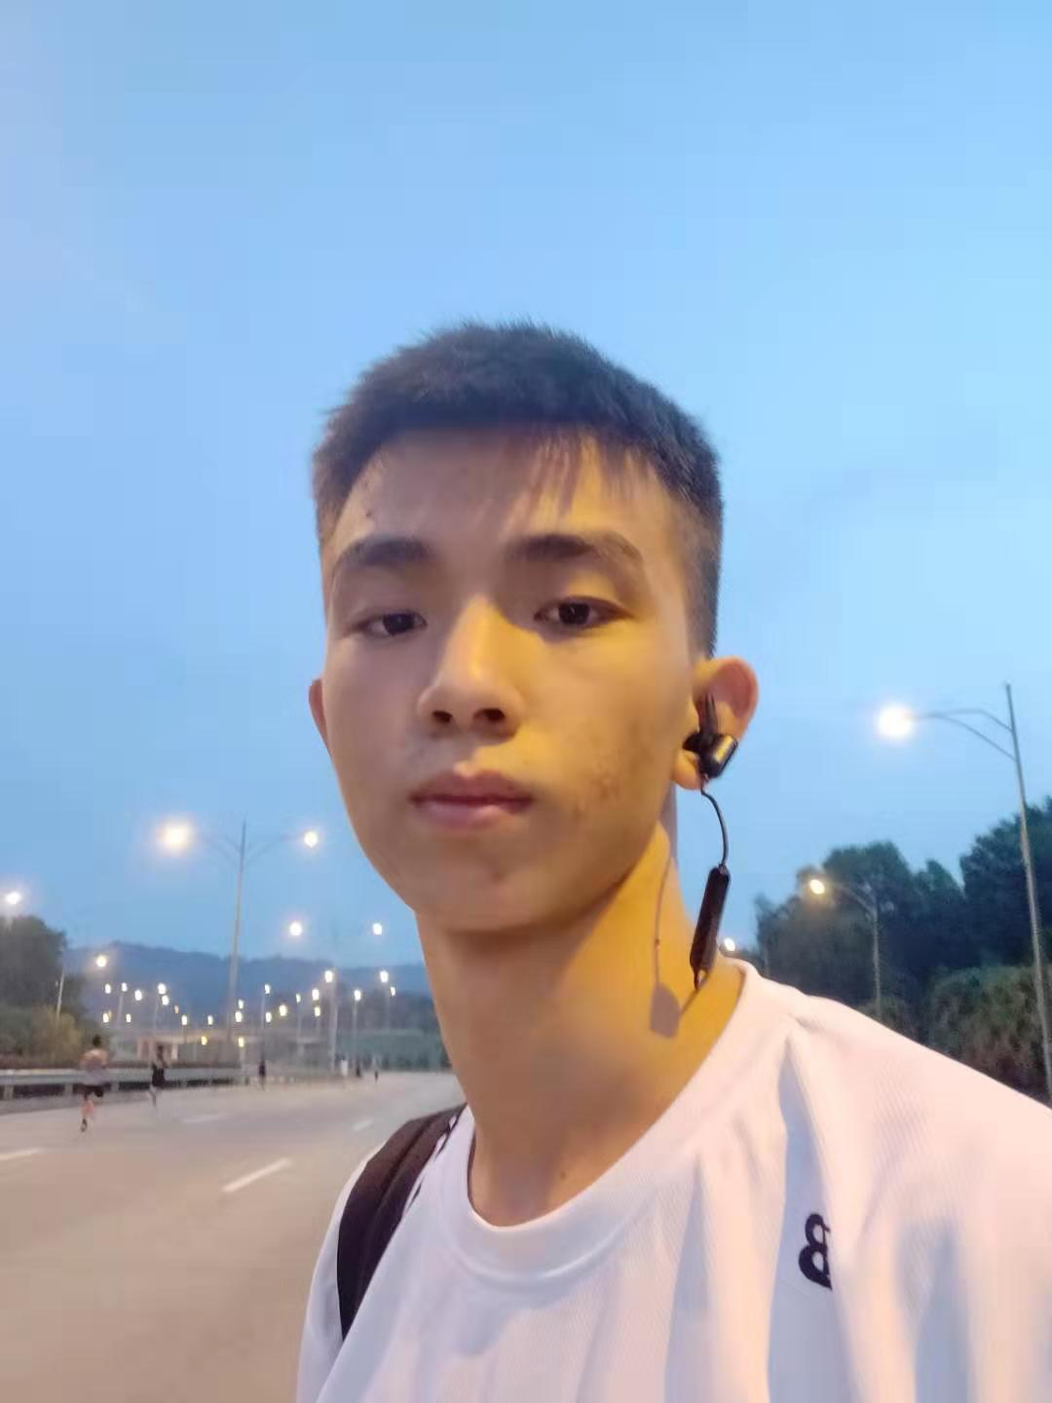
LIANGCHENHONG
CST1909141

Slide 2
My self introduction
I come from a small city in the south part of china, I am talkative and will to make friends with others. I choose the major computer science and technology for that I am interested in technology since my childhood so I choose this major to learn for four years.
I Won many awards in many math, physics, biology, chemistry of municipal competition. Won national award in Chinese writing competition when I was in high school.
I like playing basketball and swimming in my free time, I also like programming to exercise my mind.

Slide 3
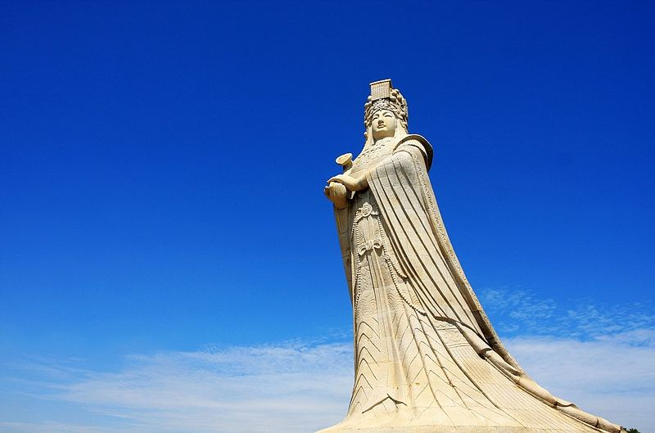
My hometown putian
Putian is a small city located in south part of the Fujian province. The people of Putian is known as the Chinese Jewish. Many of them went oversea to do some trade to build the hometown.
Meizhou island is the most famous tourist attraction in my hometown, which attract thousands of people to come to see the curve of mazu.

Slide 4
The food of my hometown
Putian is famous for its food.
Lumian it’s a kind of noodle, which add many sea food and the local food material.
Qiangrou it’s a kind of meat soup, the delicious taste of it can not express in words.
Lichi meat it’s a kind of fried meat, will appear in every banquet in putian, and children like it very much.
Men tufu, fried oyster, oyster pie and also very famous among the south part of Fujian.
There are also a restaurant called putien which is one Michelin star restaurant provide putian food in the southeast Asia.

Slide 5
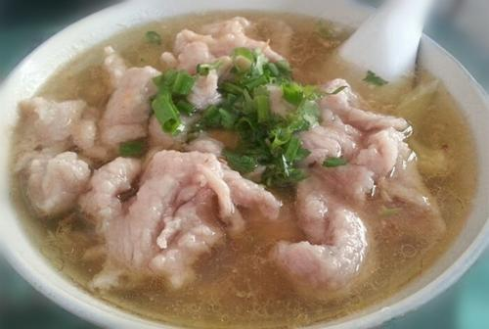
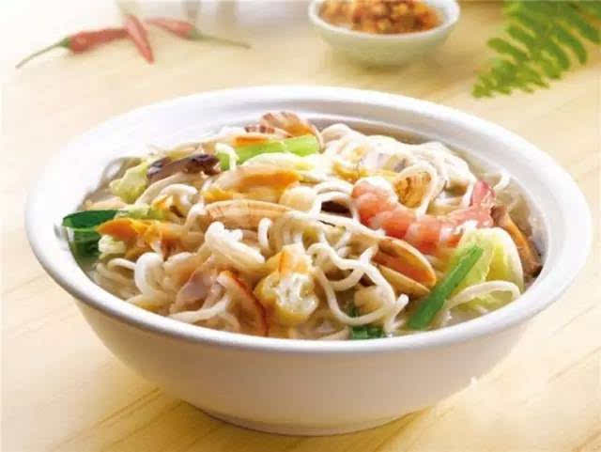
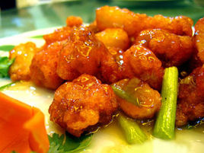
The photo of the delicious food

